Slide 1
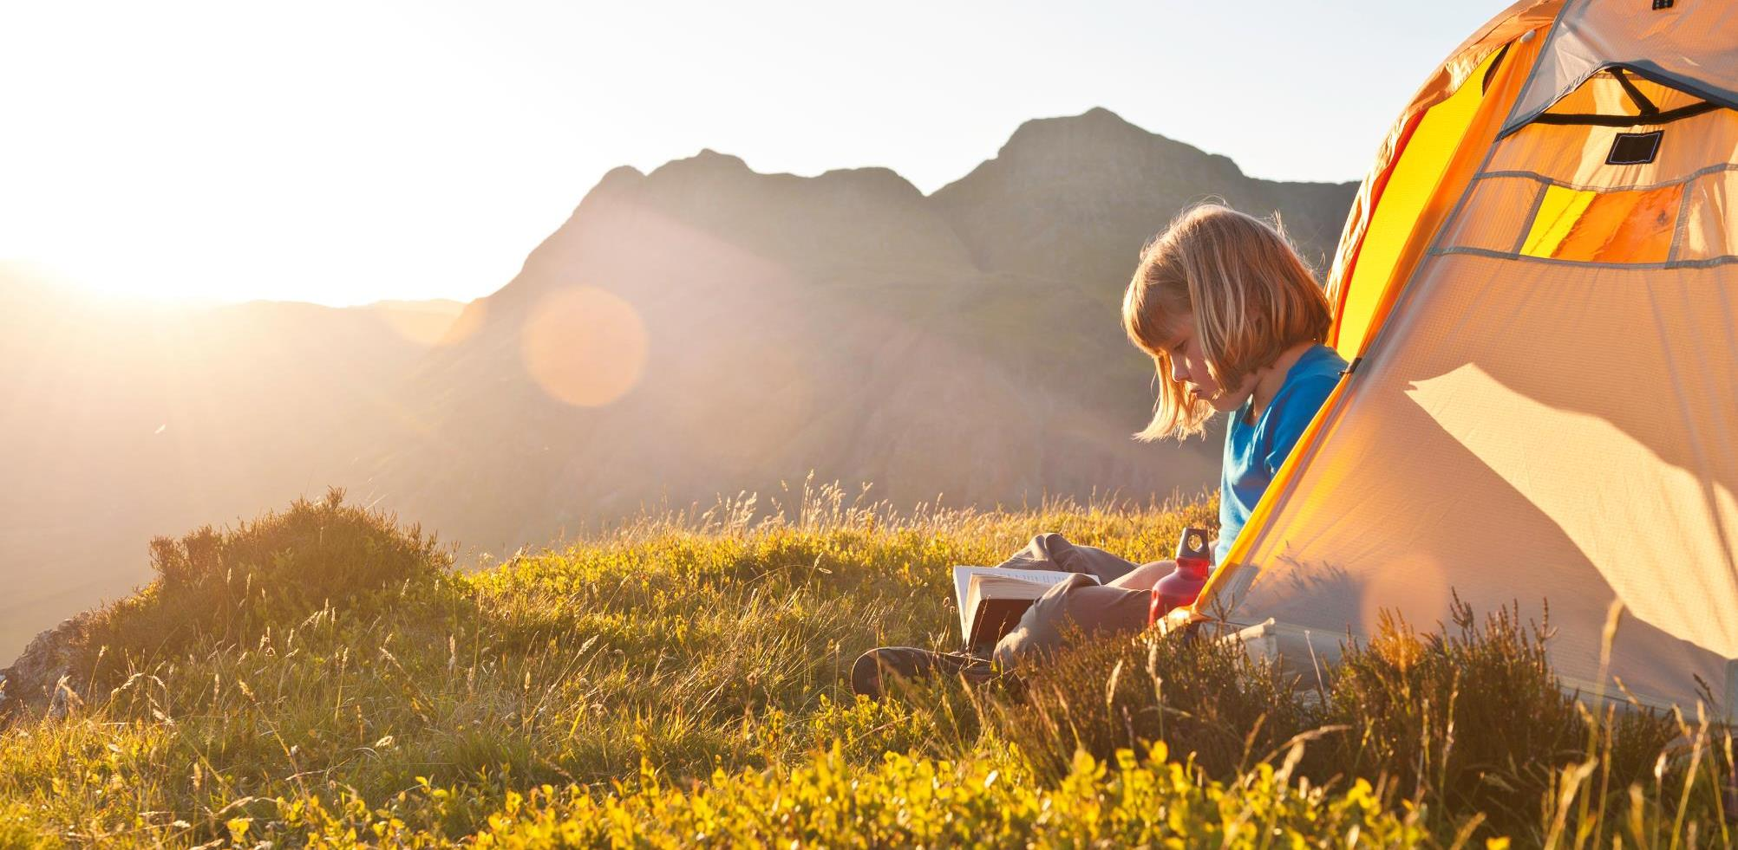
Treks -> Trips
- Manan Rajdev & Posha Dave
The way to get started is to quit talking and begin doing.
-Walt Disney

Slide 2

























MOTIVATION

Slide 3





Pages Crawled: 38K
Structured Records: 70K

Slide 4
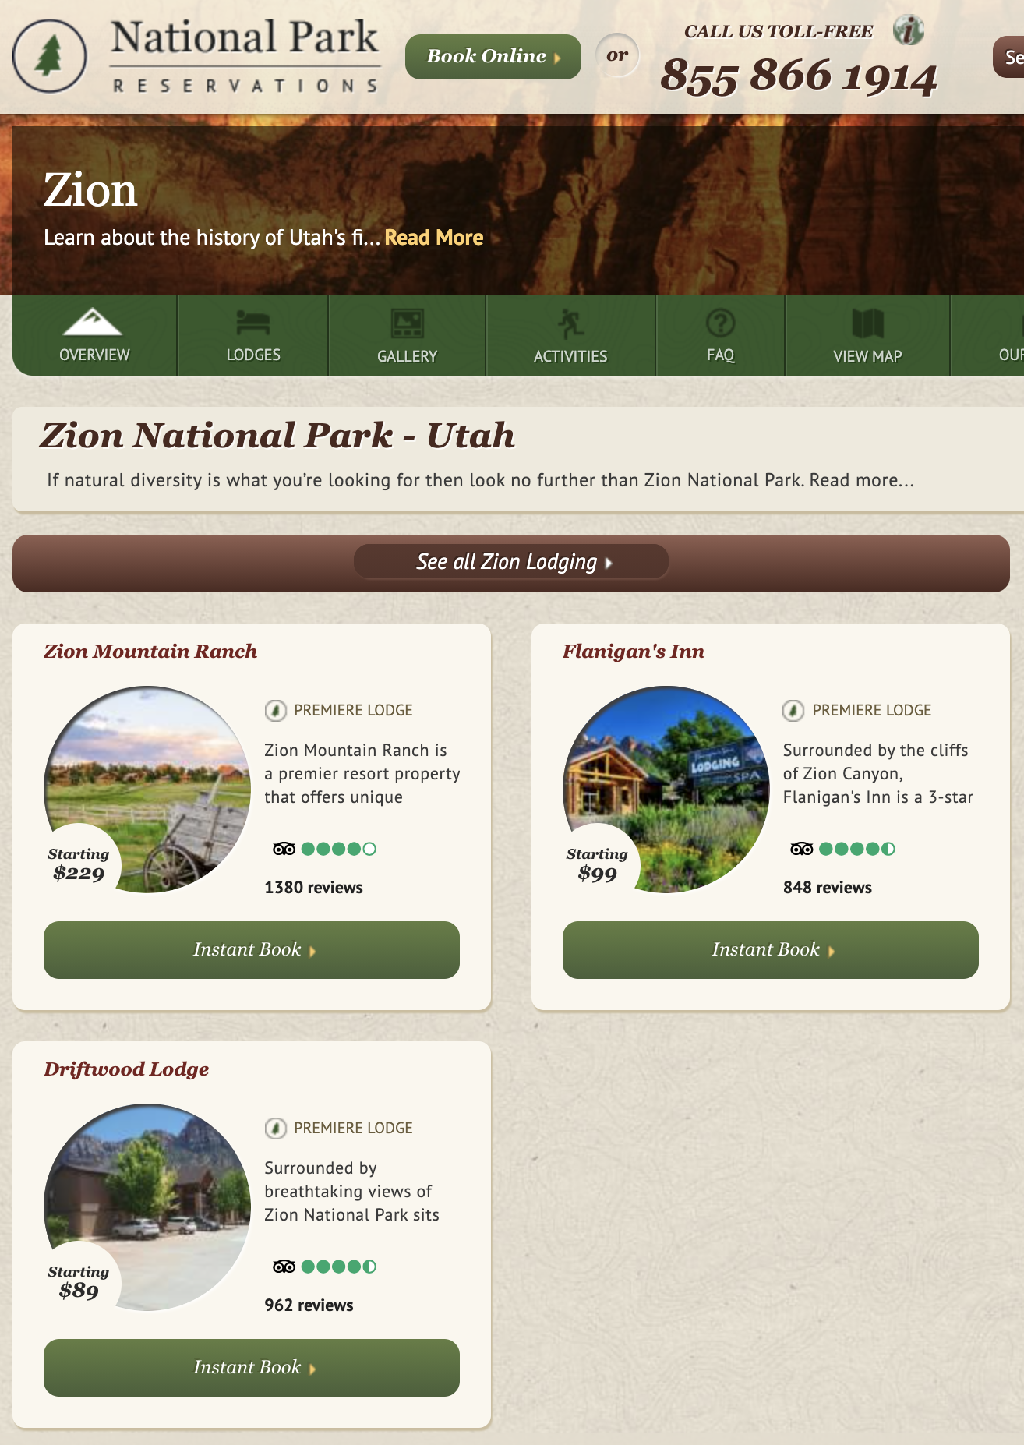
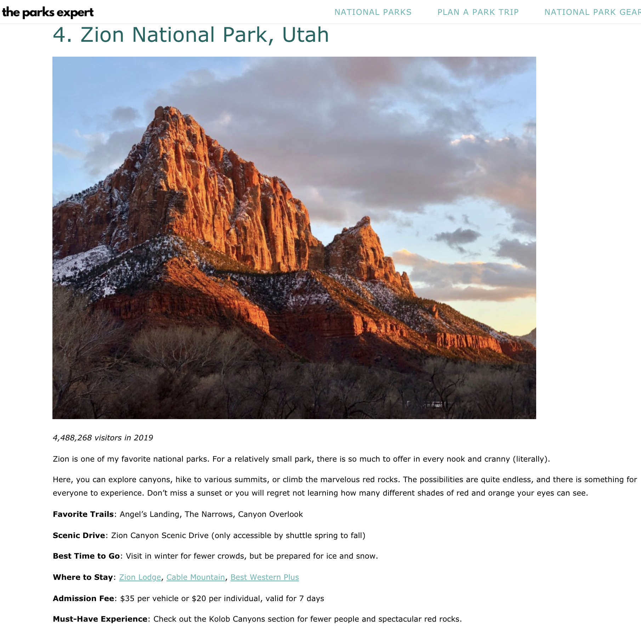
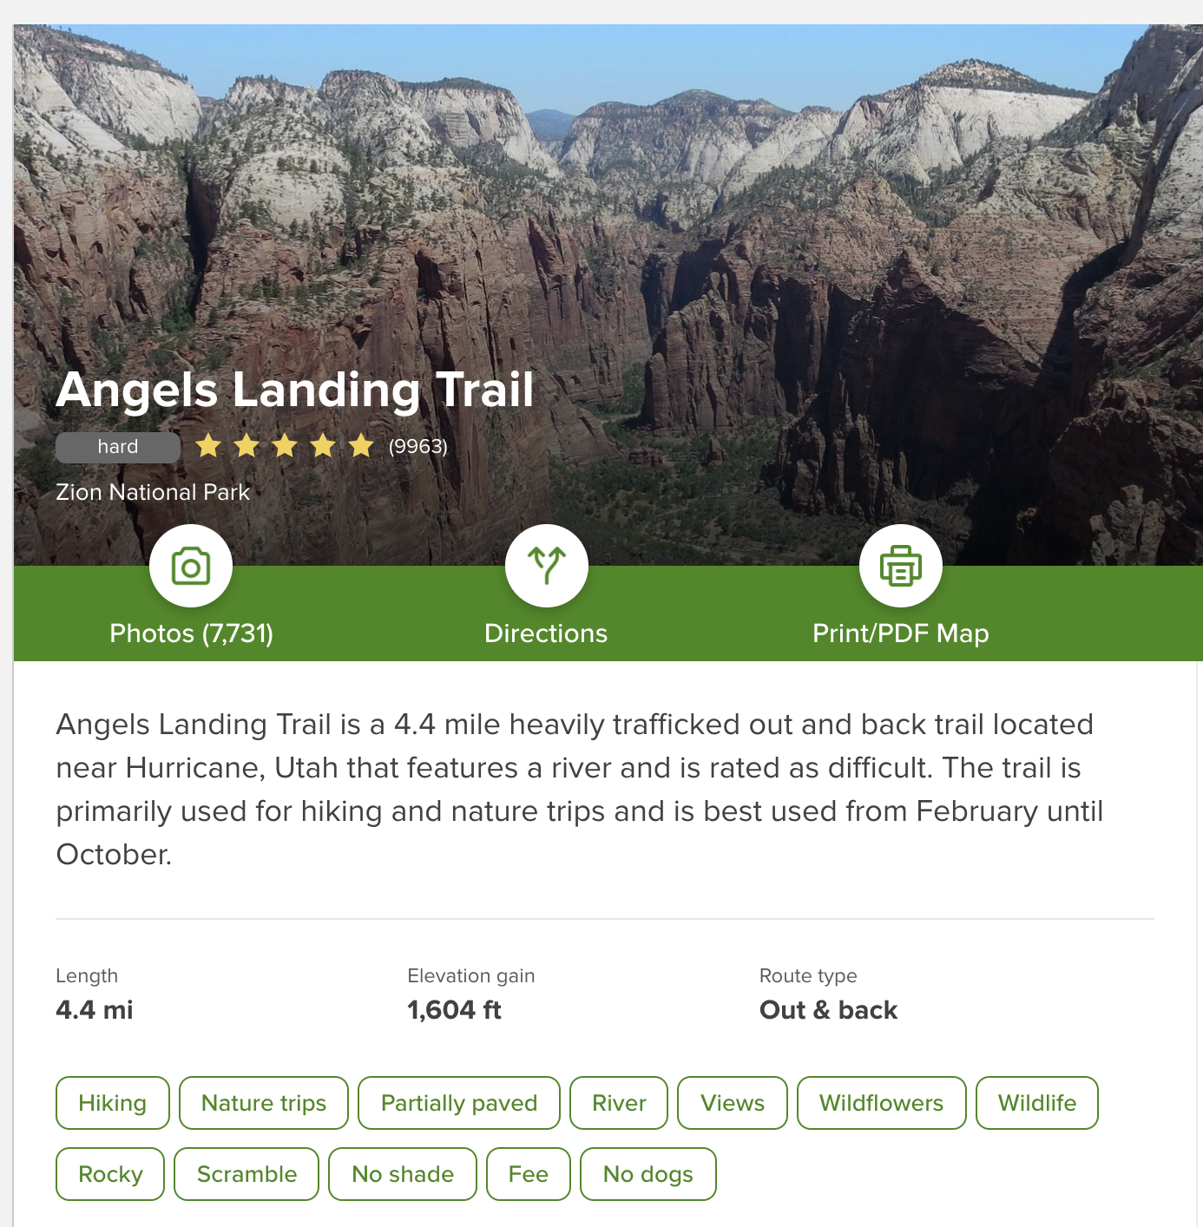

Slide 5
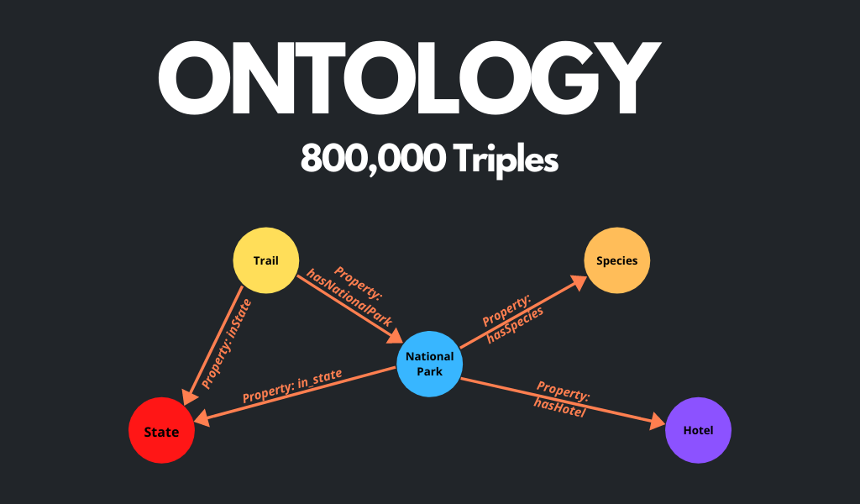

Slide 6
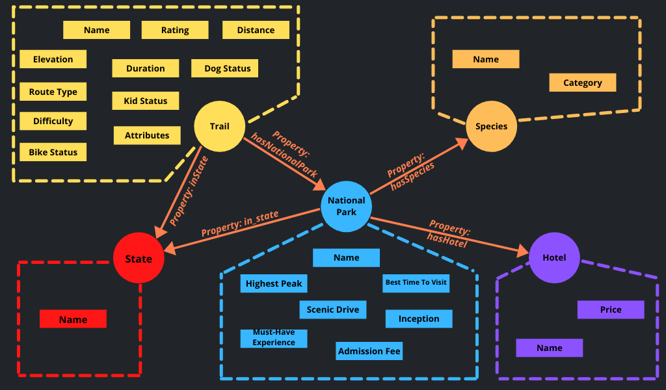

Slide 7





Slide 8
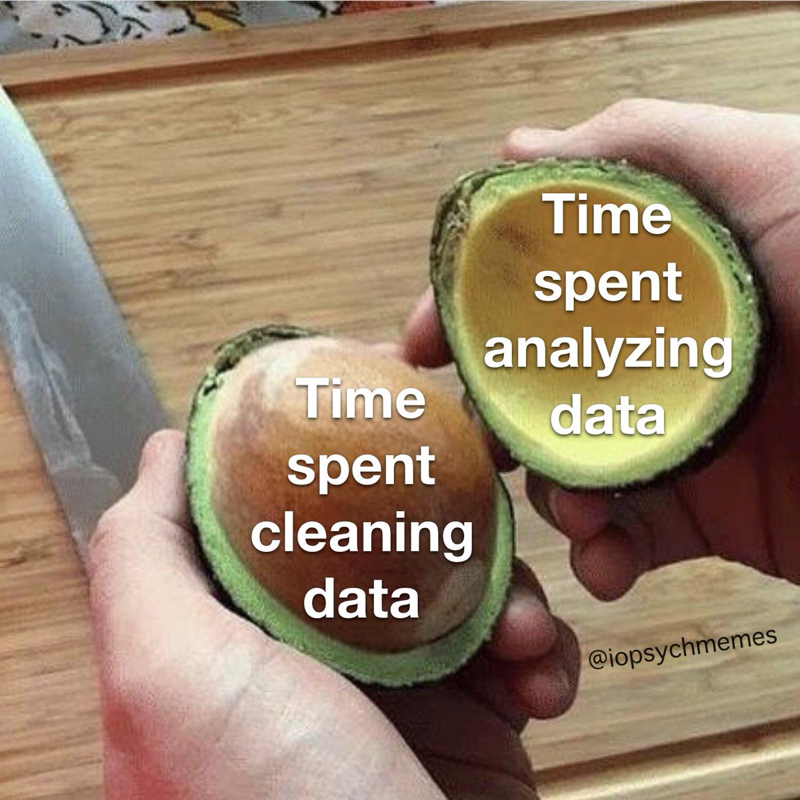


Slide 9
DATA GROUPING
Dog on Leash
Dog Friendly
Dog_Status
No Dogs Allowed
Kid Friendly
Stroller Friendly
Kid_Status
No Kids Allowed
Hot Springs
River
Water_Presence
Waterfall
Lake
Beach
Fishing
Snow
Skiing
Snow_Presence
Snowshoeing
Mountain Biking
Bike Touring
Bike_Status
Road Biking

Slide 10
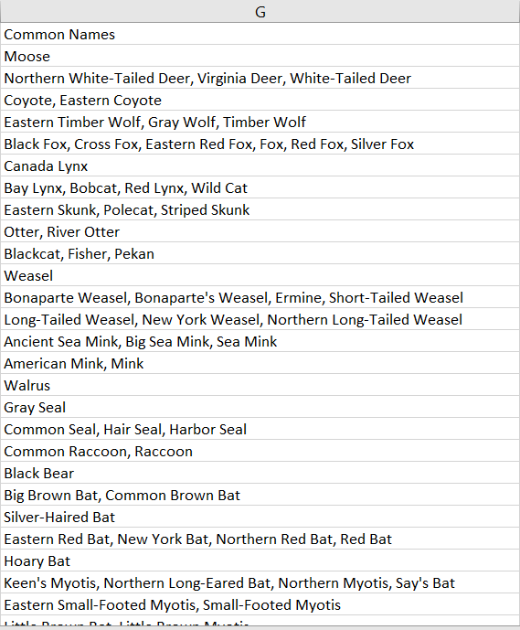
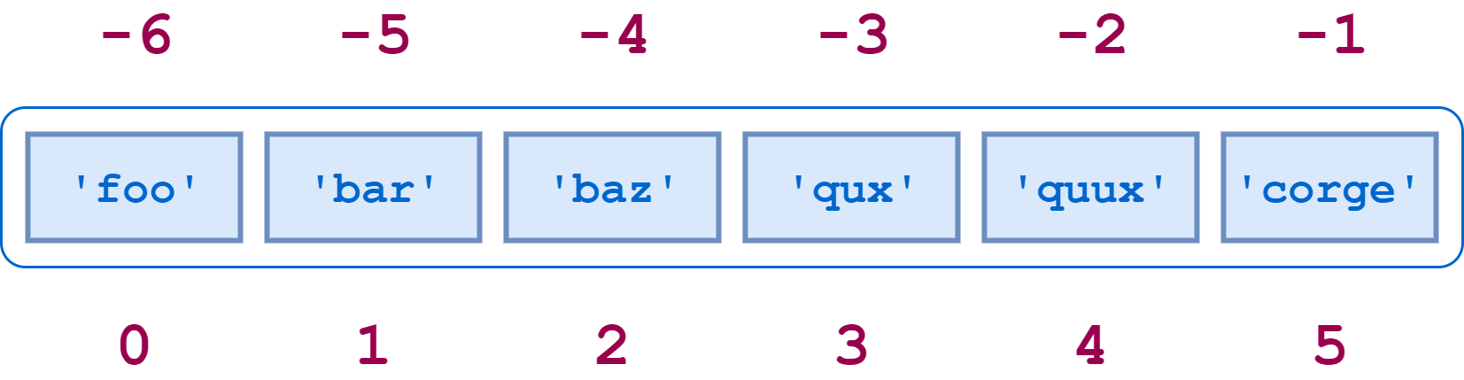
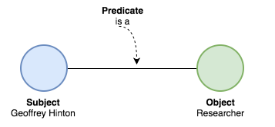
LISTS
TRIPLES

Slide 11


BLOCKING
BLOCKING
Pairs Without Blocking: ~750K
Unique Parks, Forest and Monuments: ~11K

Slide 12
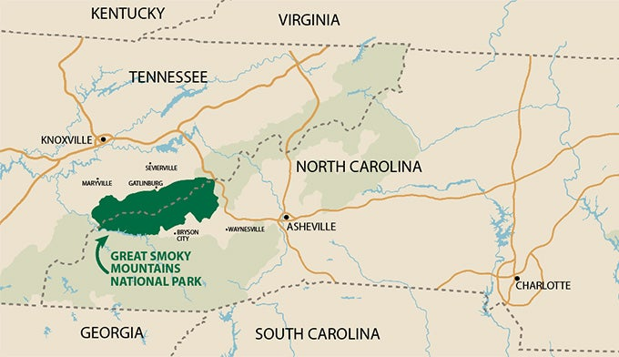

Slide 13
DATA INTEGRATION

Slide 14
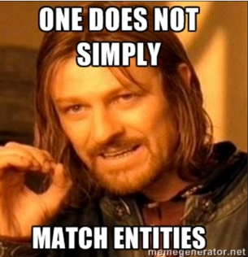
STRING SIMILARITY
Tennesse or Tennessee
National Park & Preserve -> National Park and Preserve
Canyon de Chelly National Park -> Canyon de Chelly National Monument
SOLUTION: JARO-WINKLER SIMILARITY

Slide 15
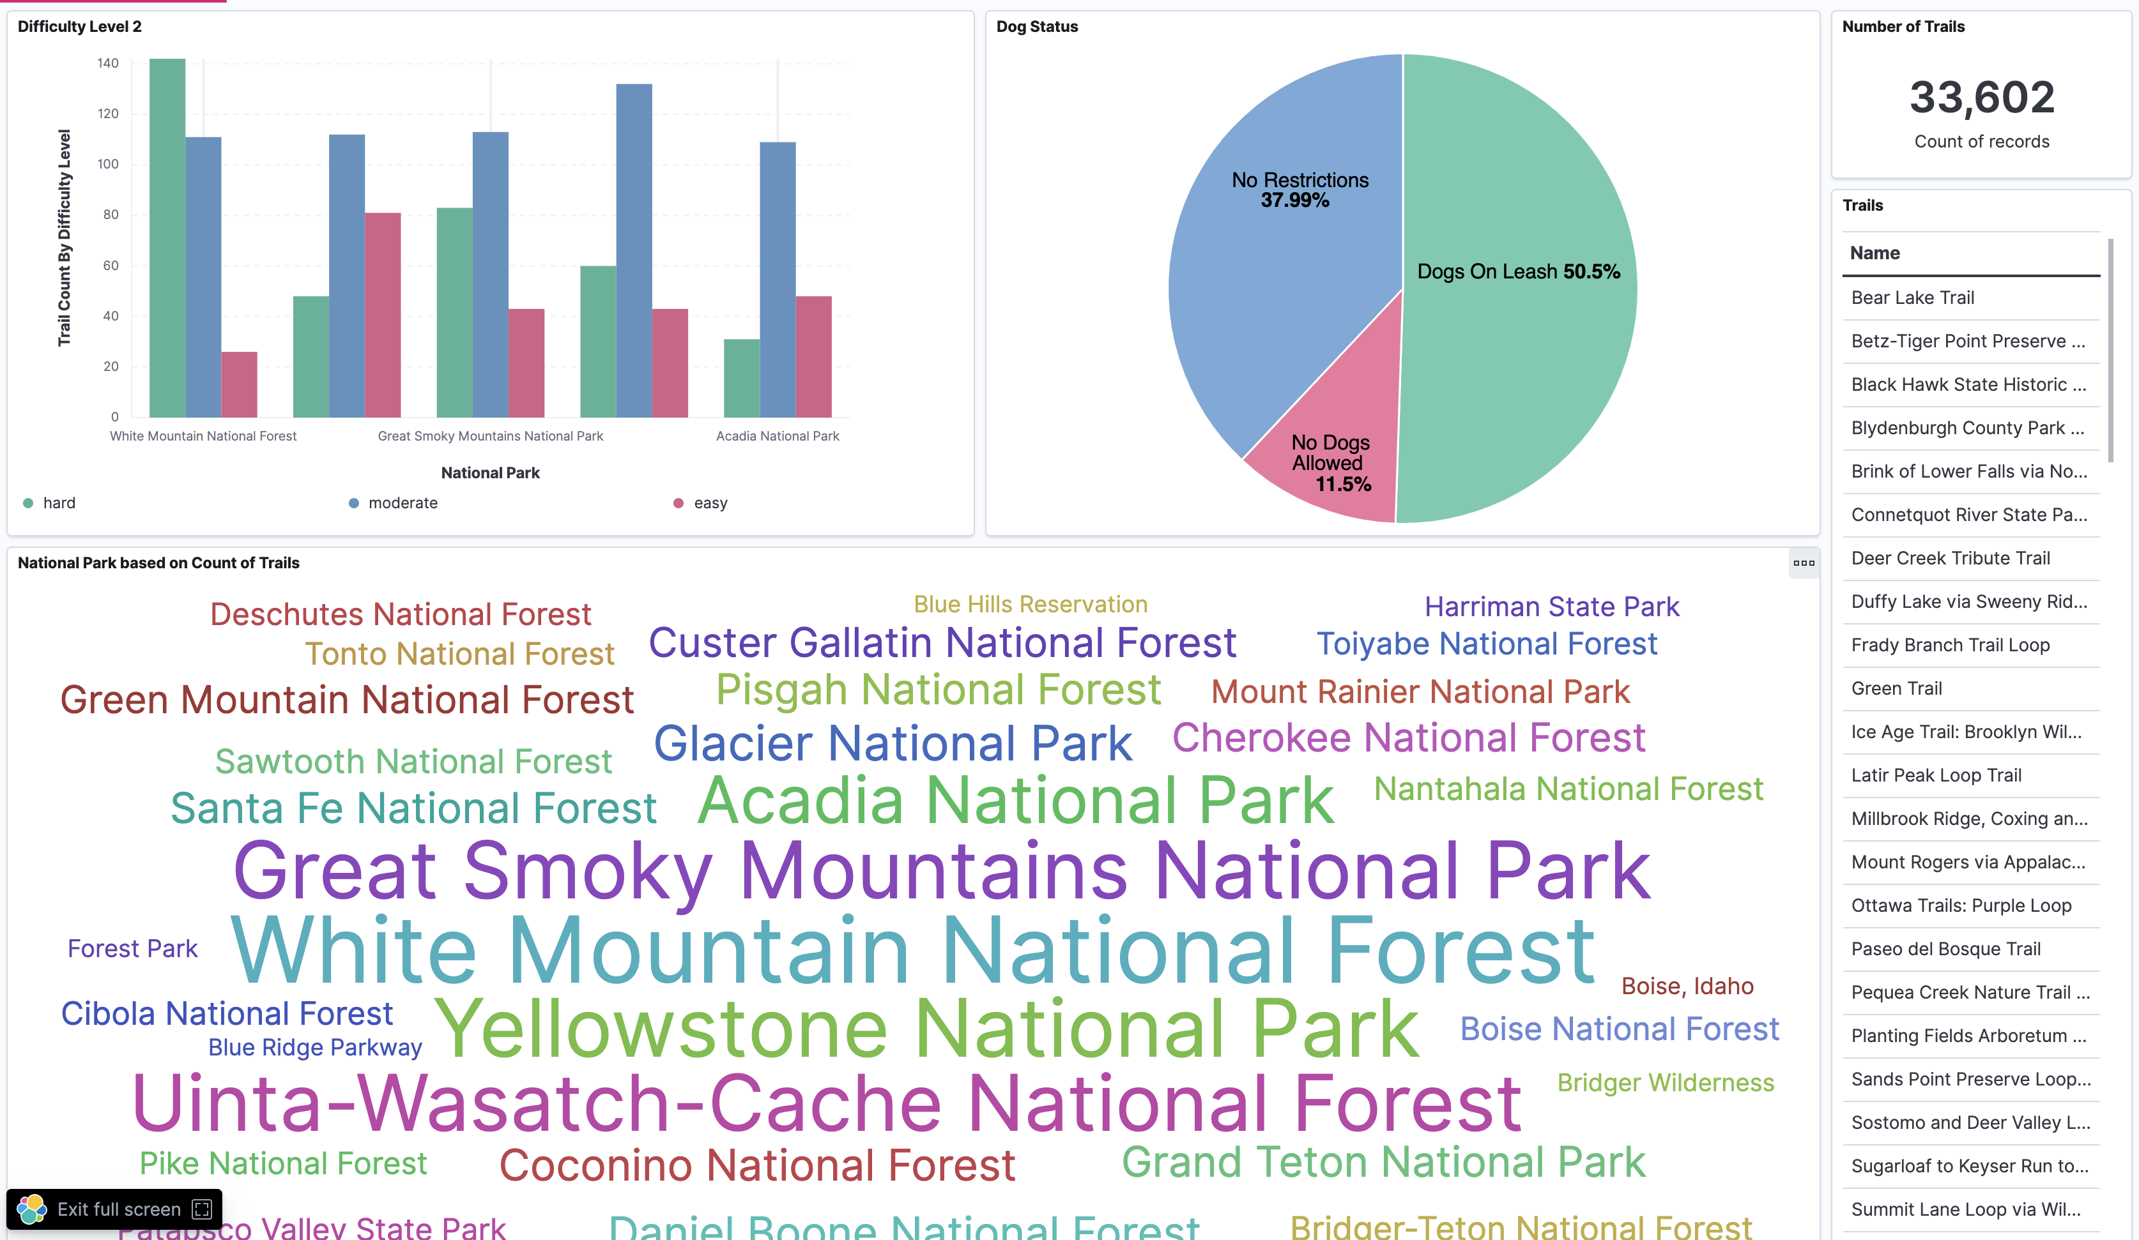

Slide 16
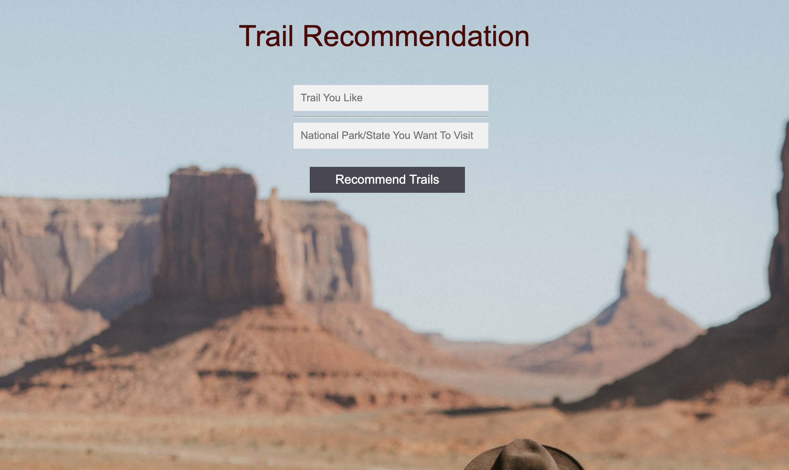

Slide 17
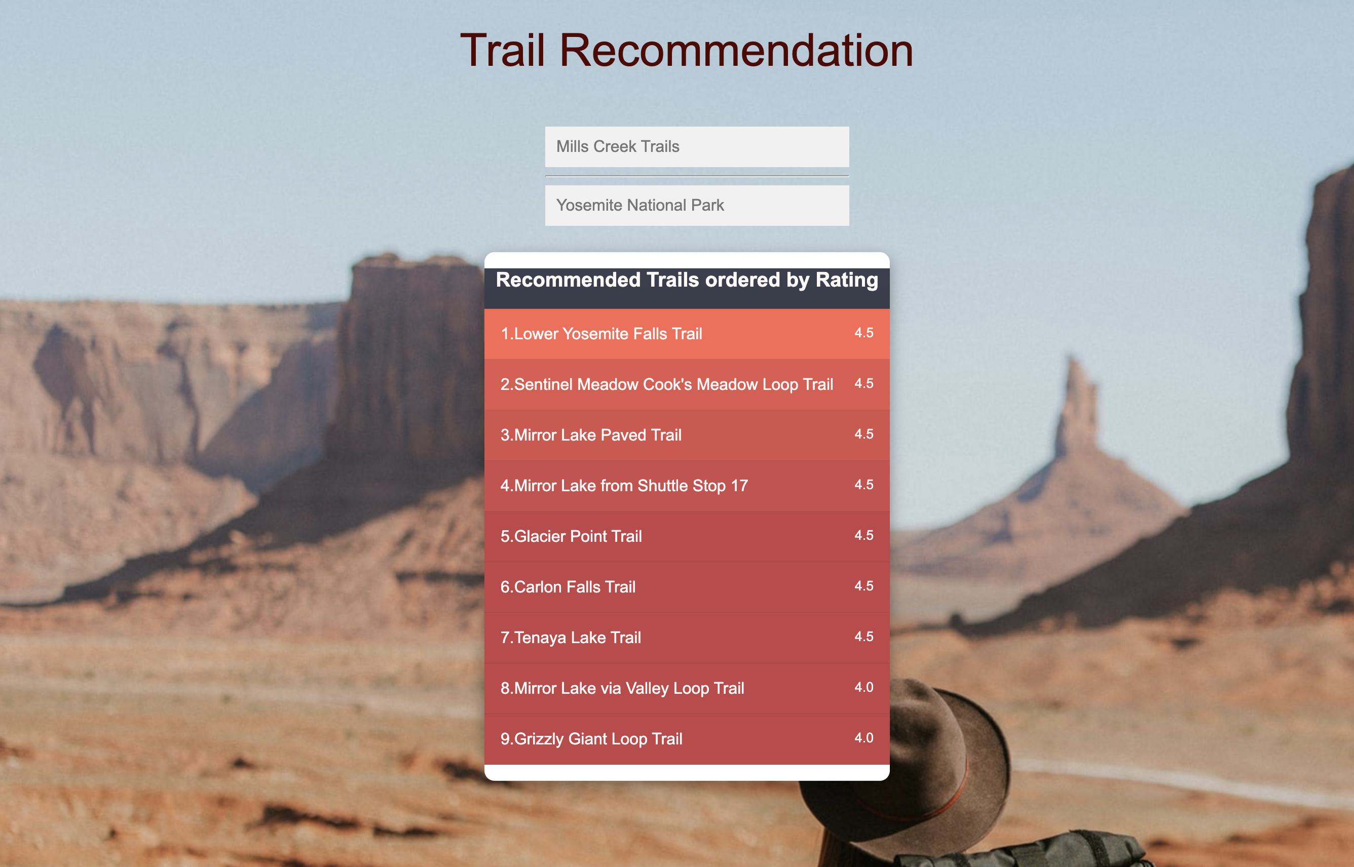

Slide 18

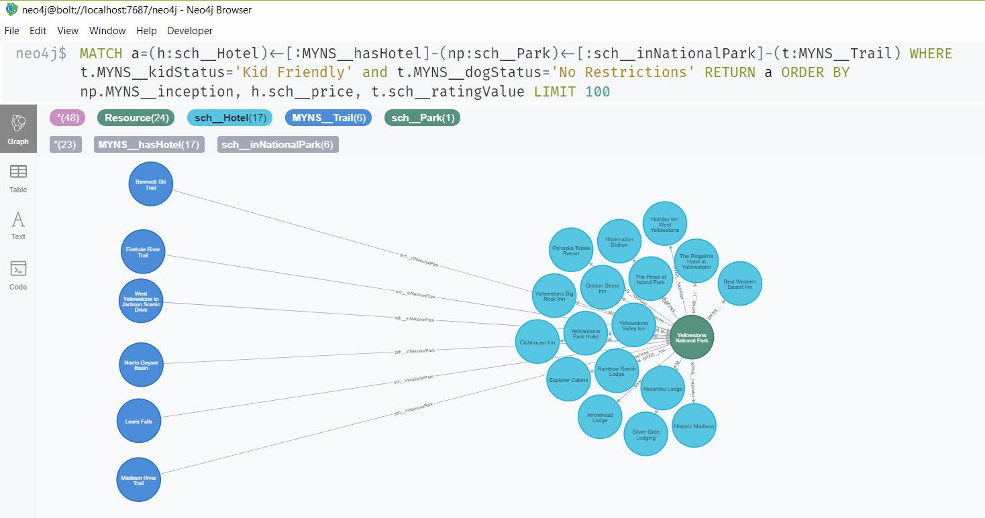
OUR PROJECT

Slide 19


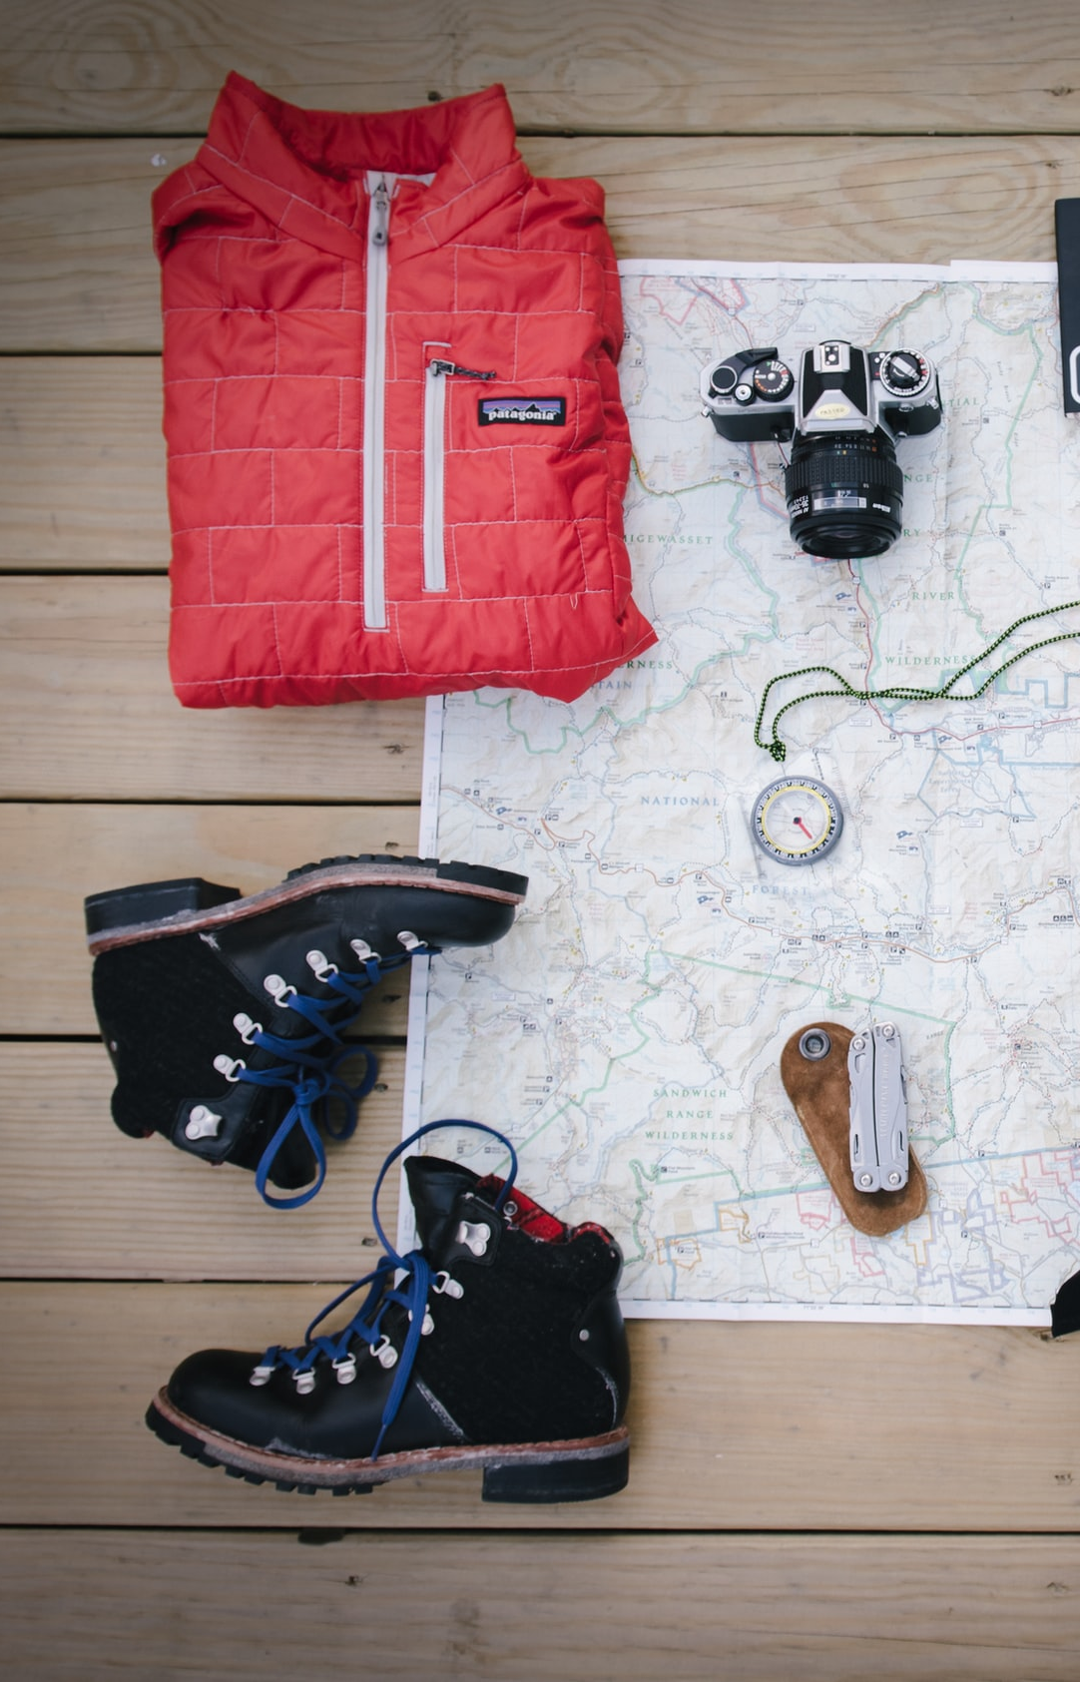
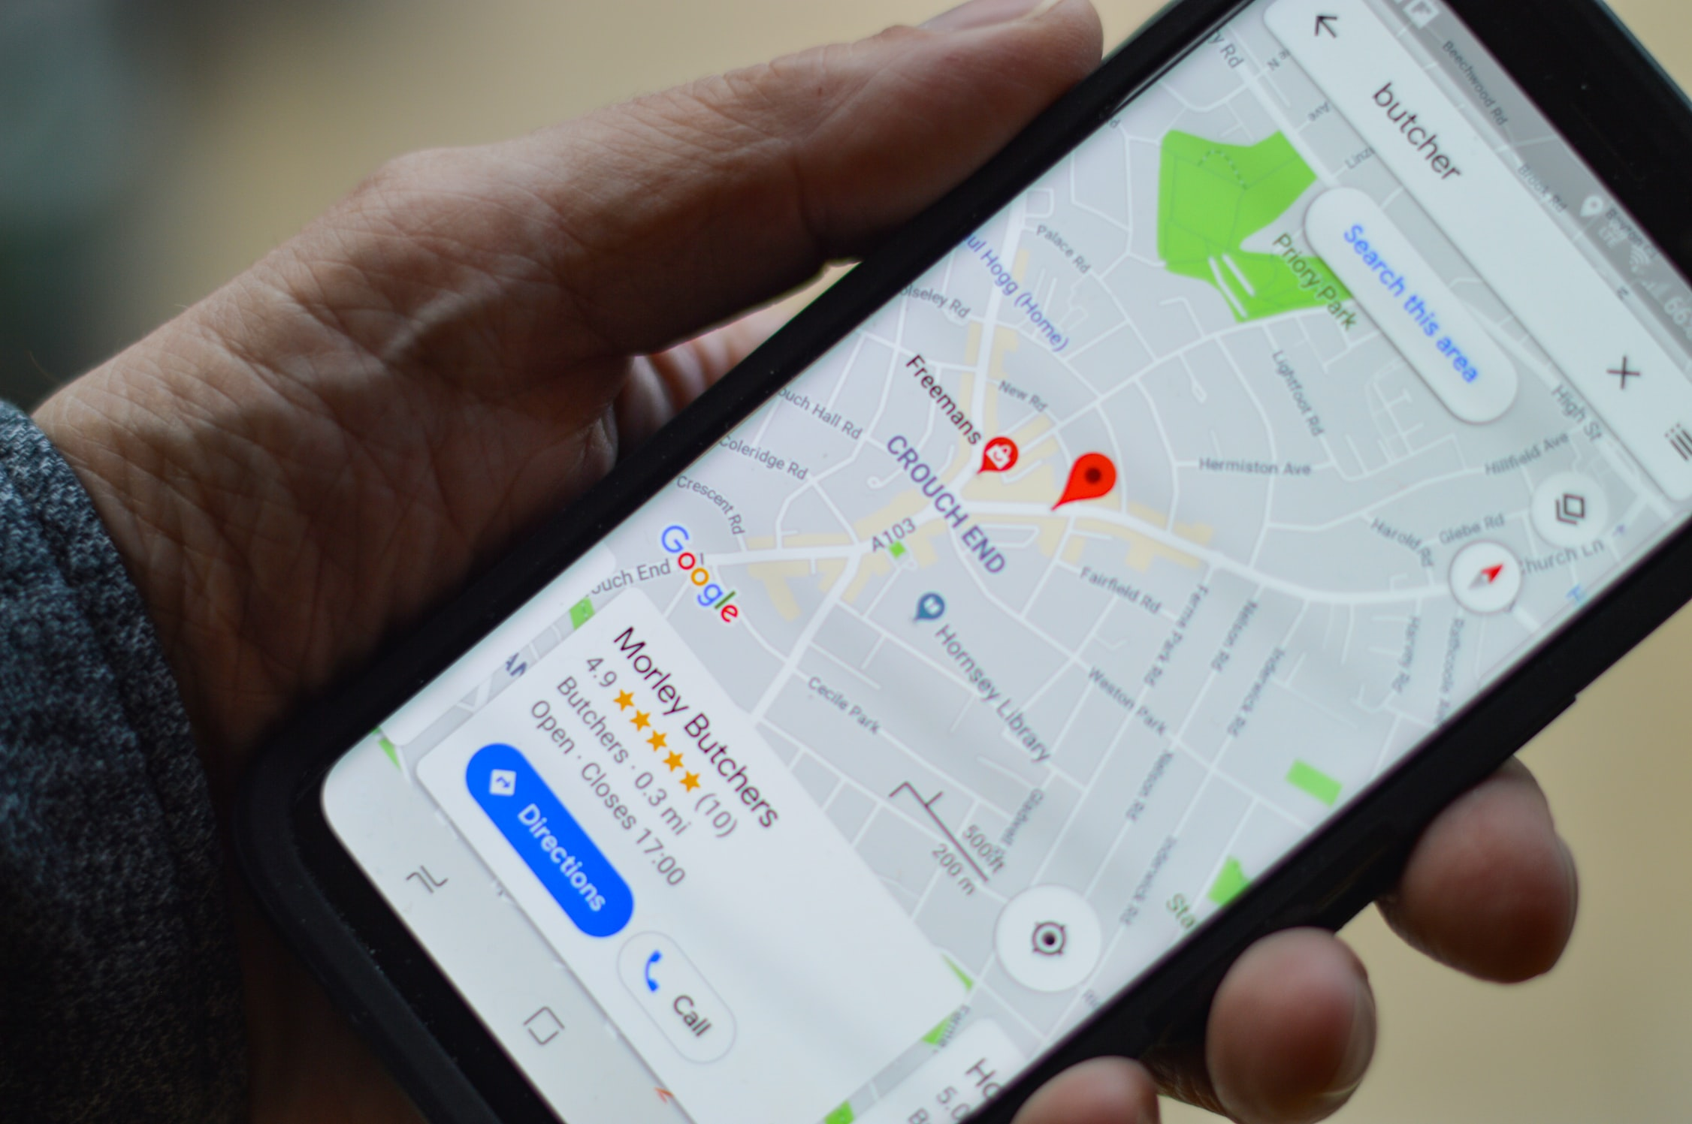
FUTURE WORK

Slide 20





Thank You

